Slide 1


Major Project
Image Depth Detection Using Deep Learning
Navkirat Singh
Arun Gera
Mentored By:
Richa Choudhary
Assistant Professor- Senior Scale
Department of Informatics
UPES, Dehradun

Slide 2
Content
Introduction
Problem Statement
Objective
Literature Review
Model
Dataset
Model Explanation
Results
Conclusion
References

Slide 3
Introduction
Depth is among the most useful intermediate representations for action in
physical environments.
Depth detection allows self driving cars to predict trajectory and even robots to calculate the path.
Over the years, with humanity becoming technologically advanced and more equipped with resources and knowledge of previous research, various algorithms have been proposed to detect the depth of the object from the source.
But research always continues inventing new algorithms and improving on previous shortcomings.

Slide 4
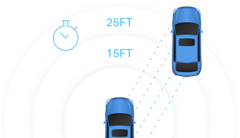
Problem Statement
Depth Detection using ultrasonic and lidar sensors is quite efficient especially with later
But in recent times with massive necessity of detecting depth nearly everywhere
for instance in autonomous cars, robots and drones
use of lidar sensor makes the already expensive product more expensive

Slide 5
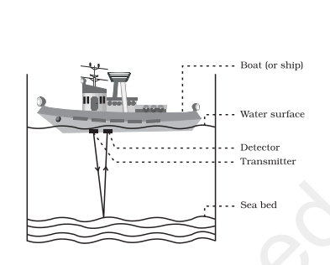
Ultrasonic Depth Detection
optical sensor that transmitter and receive, an ultrasonic signal
uses a single ultrasonic element for both emission and reception.
Uses basic physics reflection model.
Distance = ½ * Time * C
Where C is speed of light.
Not good for detecting fast moving objects

Slide 6
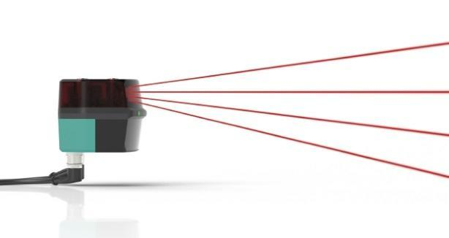
Lidar Depth Detection
Lidar (light detection and ranging)
Uses same principle as Ultrasonic
But uses eye-safe laser.
Has ability to measure 3D structures.
Can even detect small object and high
speed objects with high accuracy
But overly Expensive

Slide 7
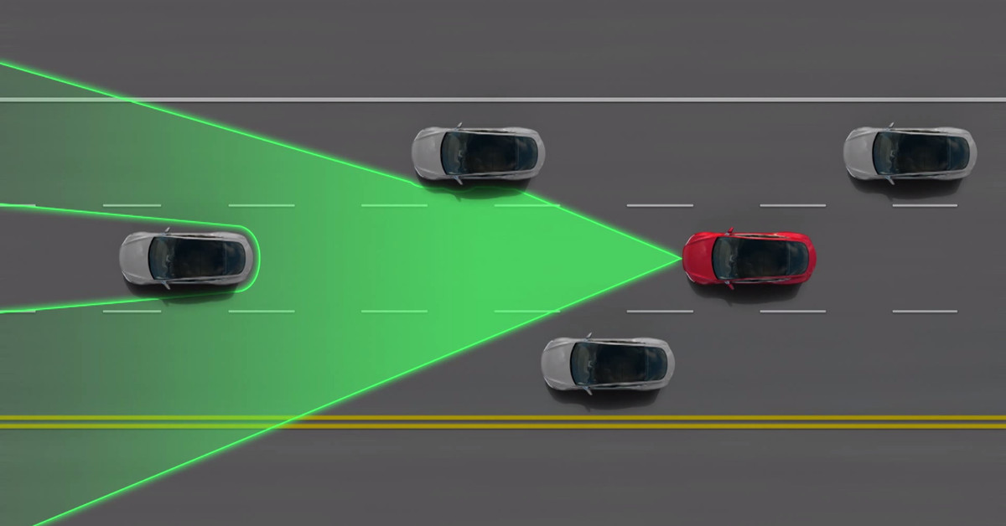

Slide 8
Vertical-cavity surface-emitting lasers (VCSELs) Or High Accuracy
Lidar cost $75,000

Slide 9
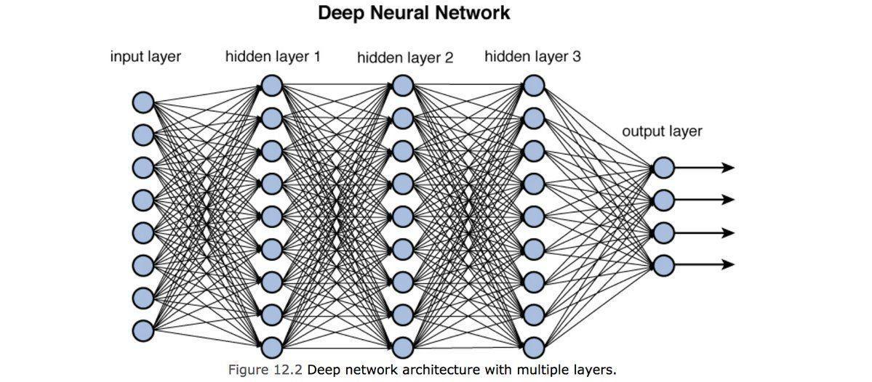
Objective - Neural Network
Goal: build deep neural network to efficiently detect the relative depth of objects in image
Eliminated the use of any hardware based device except for CPU or GPU (which is relatively inexpensive)
Harness the power of massive datasets collected over the decades using lidar.
Train and fine tune a model such that it works great on any image.

Slide 10
Literature Review
Masked Image Modeling - Masked image modeling (MIM) is a sub-task of masked signal prediction,that masks a portion of input images, and lets the deep networks predict the masked signals conditioned on the visible ones.
Image Segmentation - Image segmentation is the task of clustering parts of an image together that belong to the same object class. This process is also called pixel-level classification. In other words, it involves partitioning images (or video frames) into multiple segments or objects.
We used Semantic segmentation instead of instance
Backbone Architectures - Masked image modeling is mostly studied in the Transformer architectures, thus the major understandings and experiments in this paper are performed on Vision

Slide 11
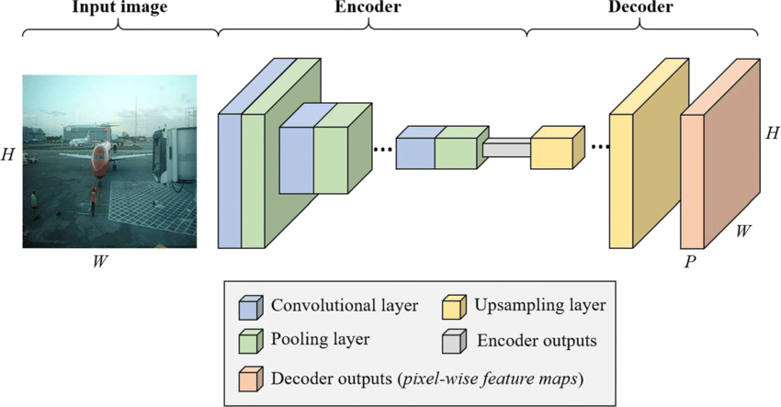
Model Architecture

Slide 12
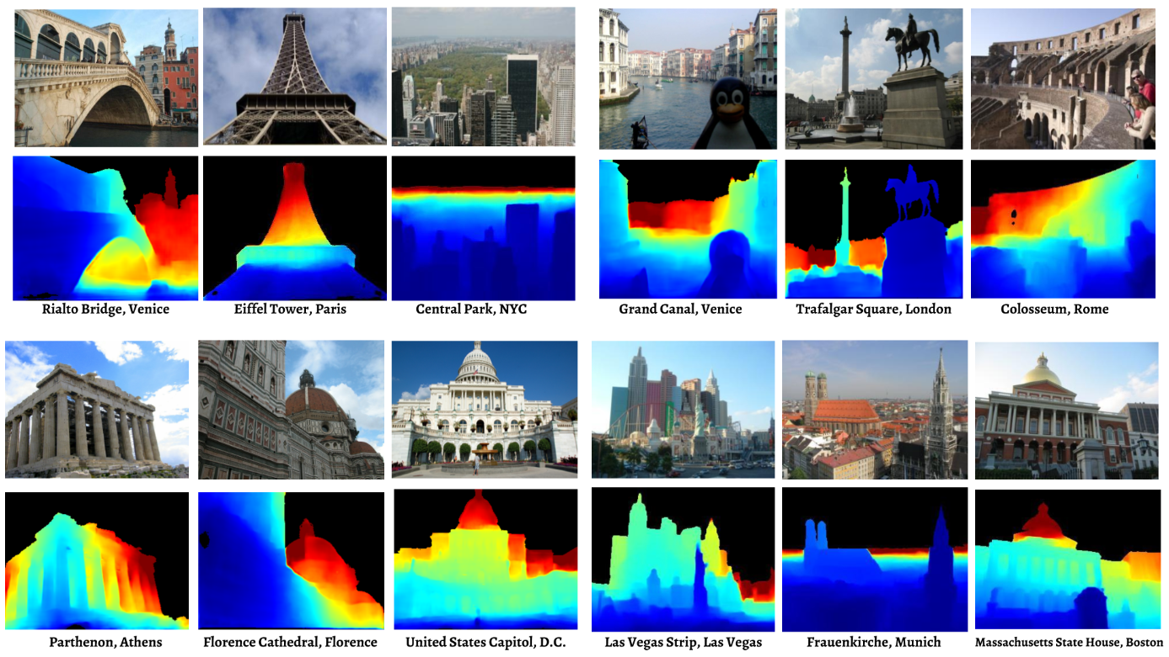
Training Dataset
MegaDepth: Learning Single-View Depth Prediction from Internet Photos

Slide 13
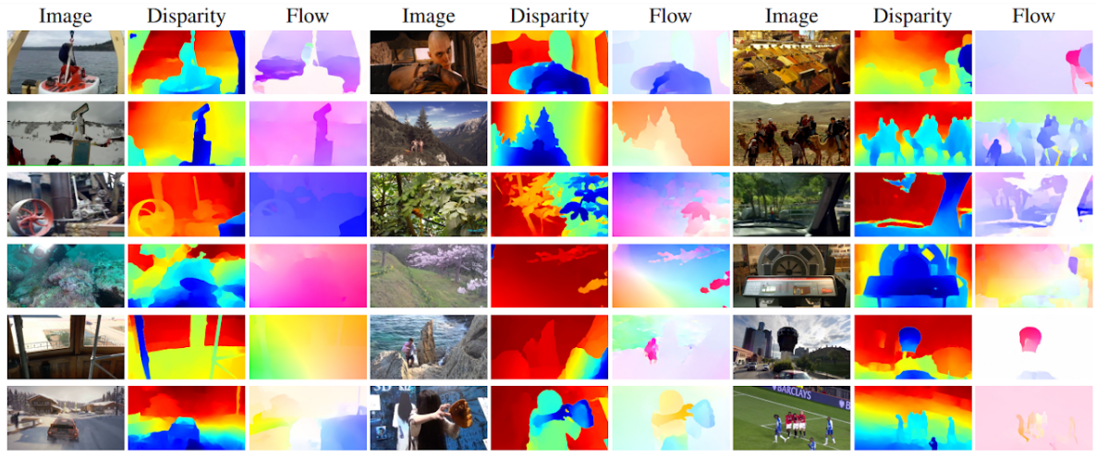
Validation Dataset
Web Stereo Video Supervision for Depth Prediction from Dynamic Scenes (WSVD)

Slide 14
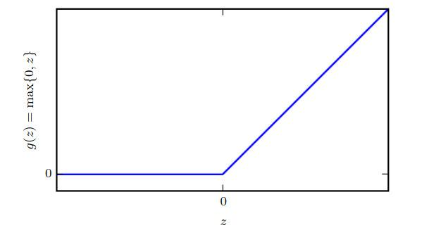
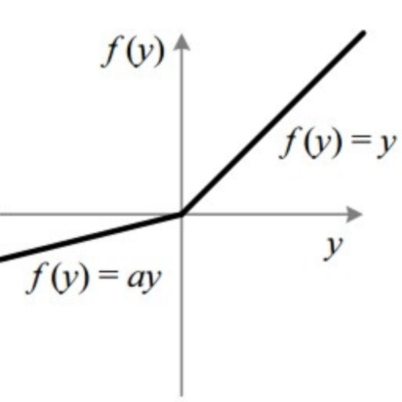
Activation Function
most vital component of neural network
used to map non-linear function using neural network.
used ReLU and leakyReLU in depthNet

Slide 15
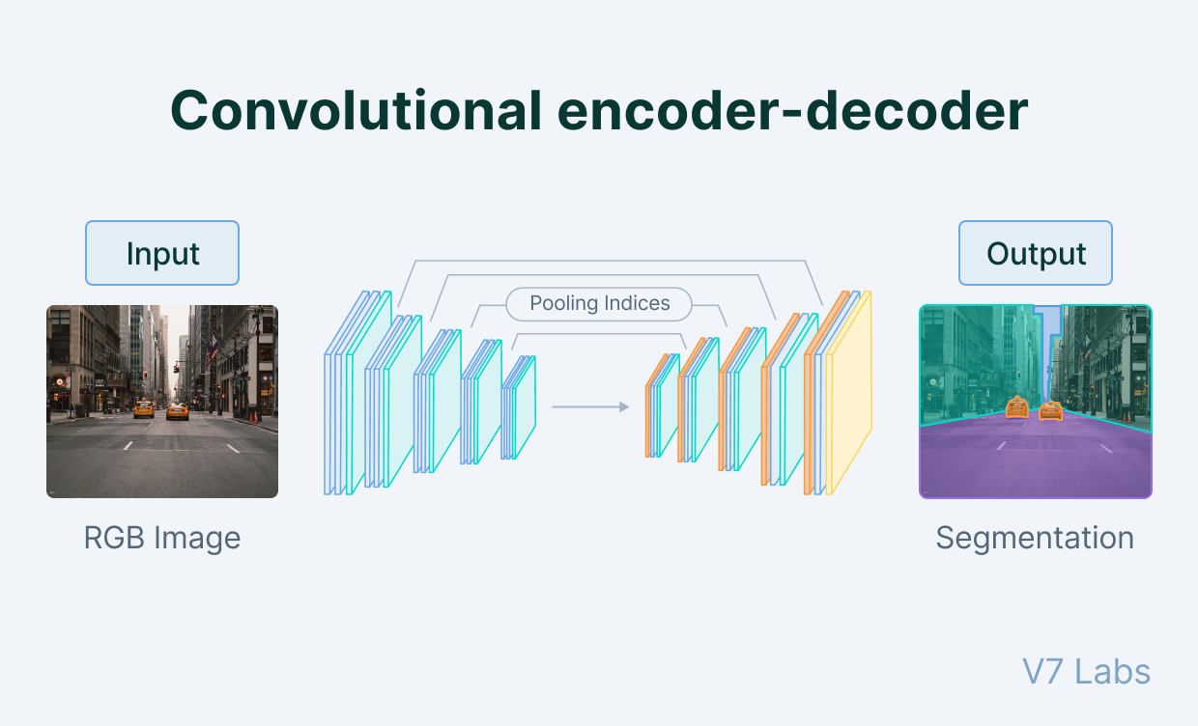
Encoder Component
Maps the input image of to latent vector
Takes input an image of size 128x128x3
Applies 11 convolutional layers along with ReLU activation to learn the patterns in image
Applies 11 average pooling layer to decrease dimension of image, as its passed through network
Maps the input image to 1x1x64 latent vector to be passed in decoder

Slide 16
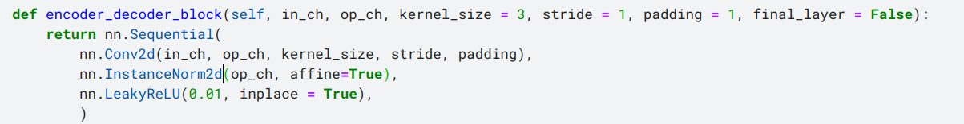
Encoder Decoder Network

Slide 17
Decoder Component
Maps the latent vector to output image
Takes input an latent vector of size 1x1x64
Applies 7 deconvolutional layers along with leaky ReLU activation to learn the patterns in image
Applies 7 upsampling layer to get original dimension of image, as its passed through network
Maps the input latent vector of 1x1x64 to image of size 128x128x3

Slide 18
Concatenating encoder decoder together

Slide 19
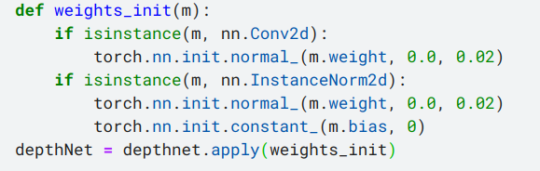
Model and Weight Initialization
For model to learn properly weights must be initialized carefully
nor too large nor too small
hence initialized weight from normal distribution
with mean 0 and variance 0.02

Slide 20
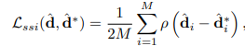
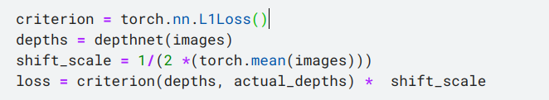
Loss Function : Scale and shift invariant Loss Function
The choice of the loss function is important as it plays a vital role in providing feedback to the neural network.
Gradient over the loss helps minimise the loss and help network learn
We take scaling factor p = 1 because only required in video

Slide 21
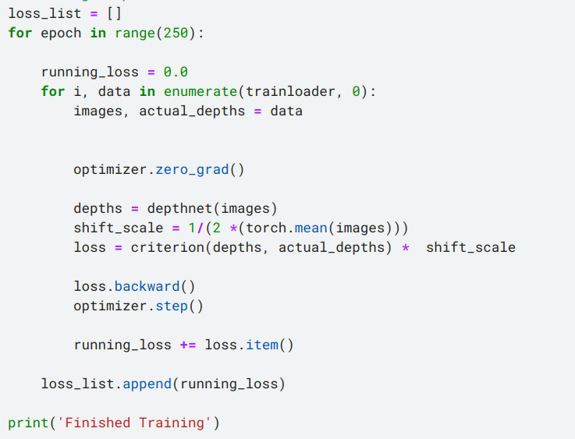
Training Phase
Trained model for 10 hrs daily for 30 days
For training purpose variation of pure gradient descent was used i.e RMSProp.
Trained on Nvidia T4 GPU 16 GB

Slide 22
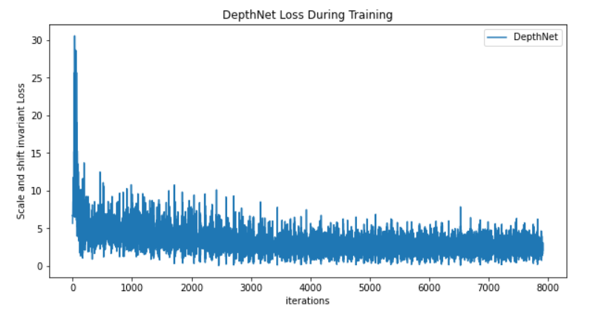
Training Phase

Slide 23
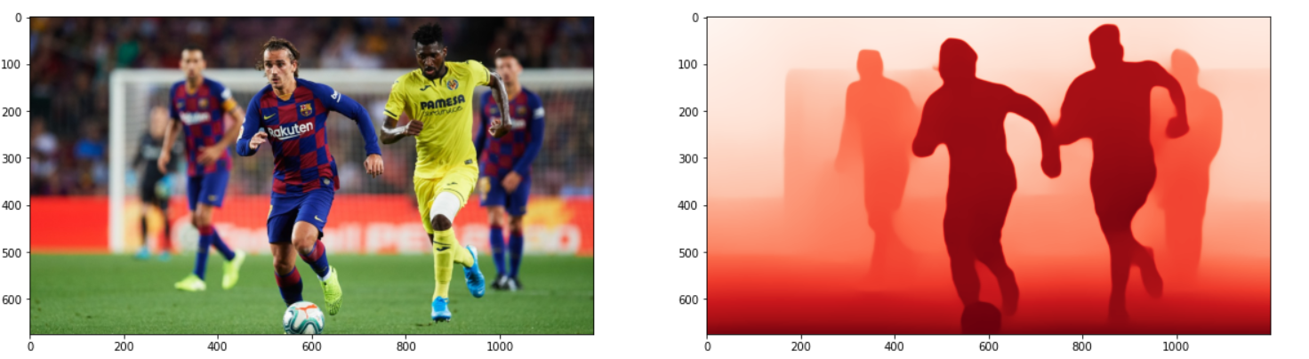
Predictions and Testing on Random Internet Images

Slide 24
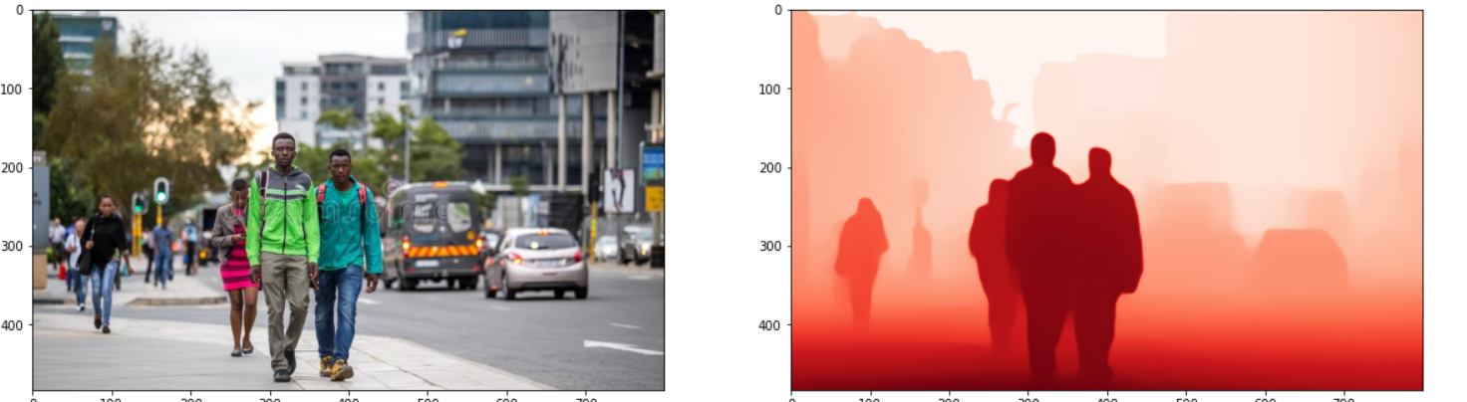
Predictions and Testing on Random Internet Images

Slide 25
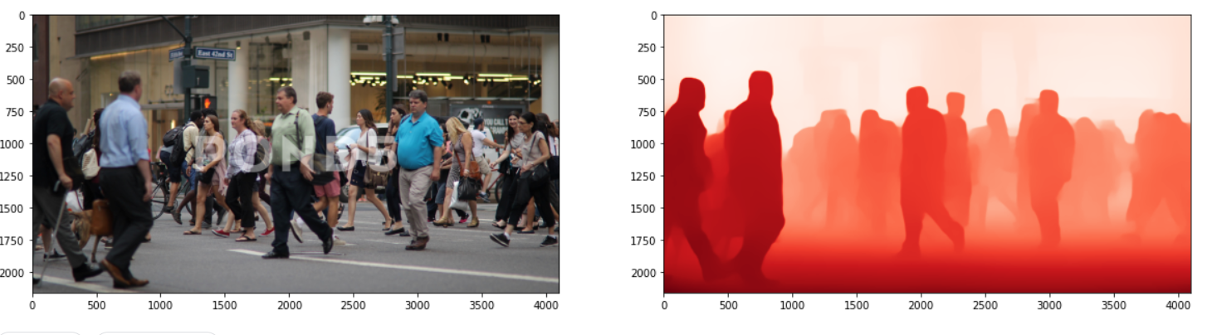
Predictions and Testing on Random Internet Images

Slide 26
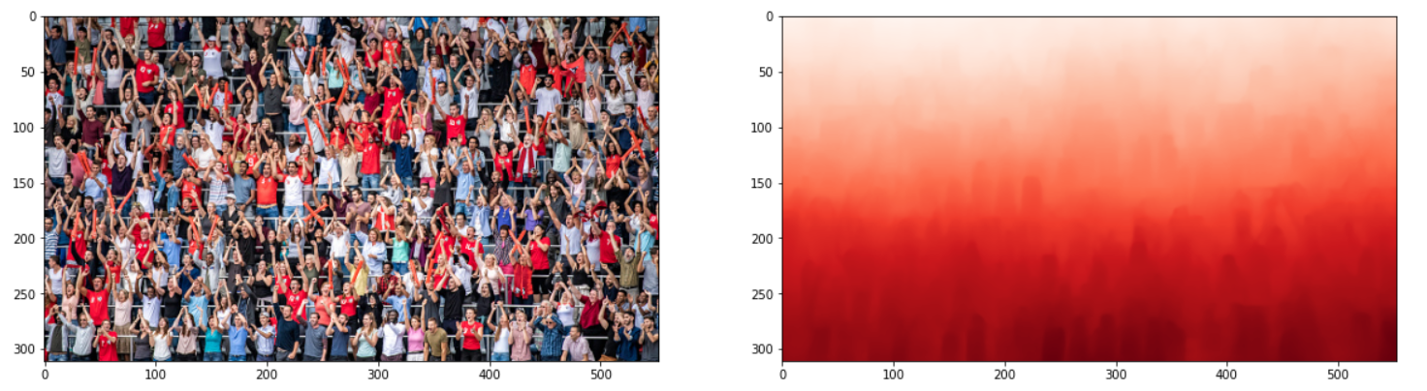
Predictions and Testing on Random Internet Images

Slide 27
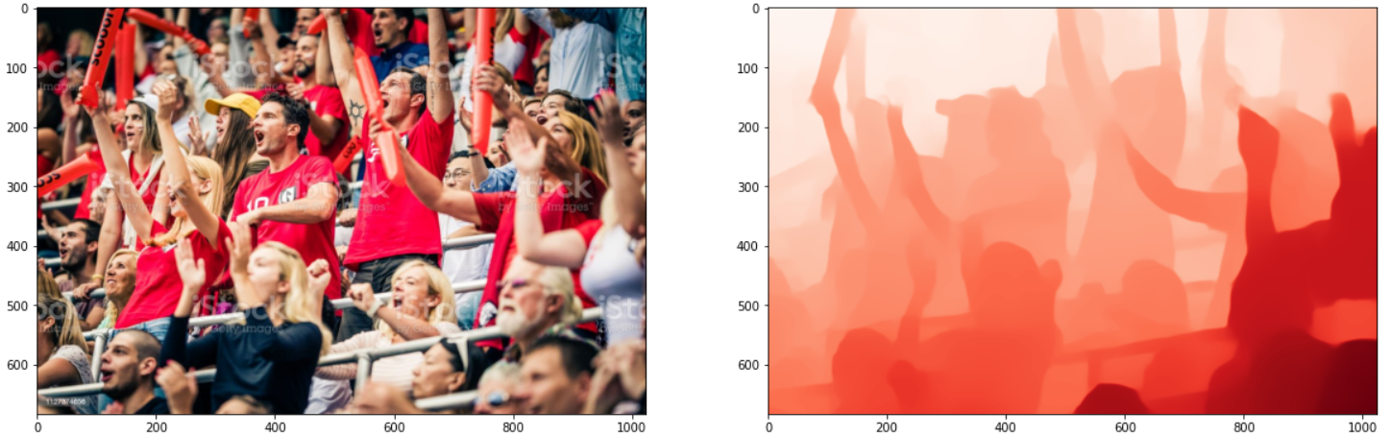
Predictions and Testing on Random Internet Images

Slide 28
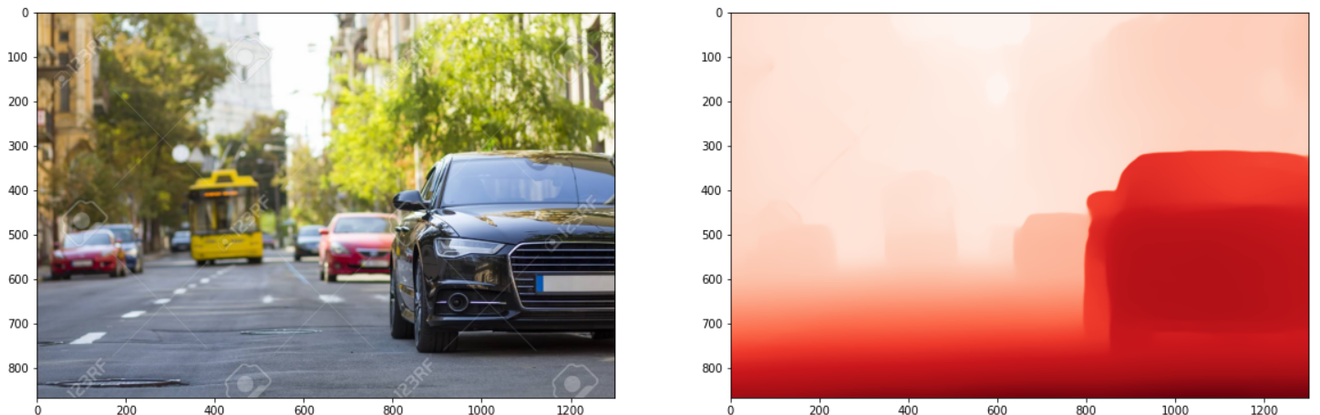
Predictions and Testing on Random Internet Images

Slide 29
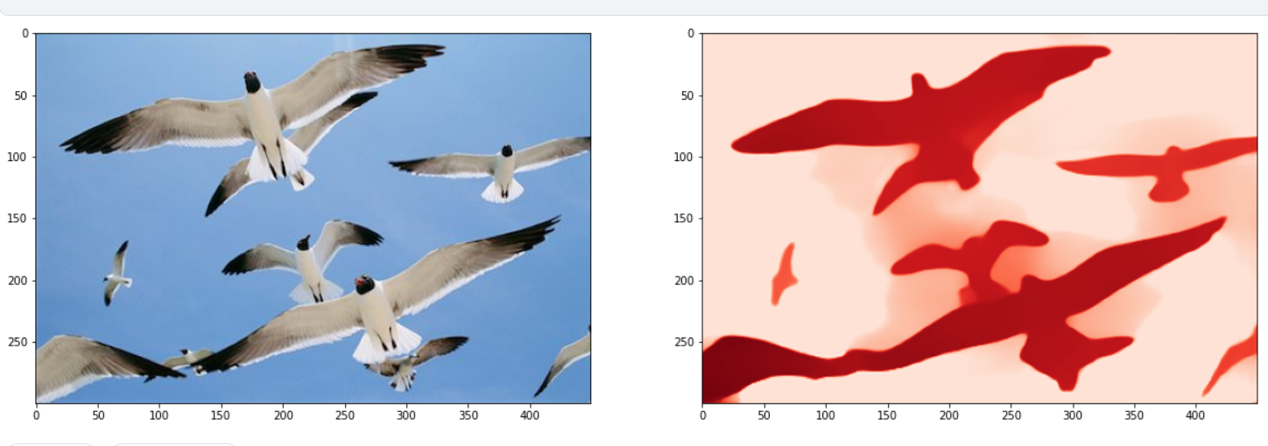
Predictions and Testing on Random Internet Images

Slide 30
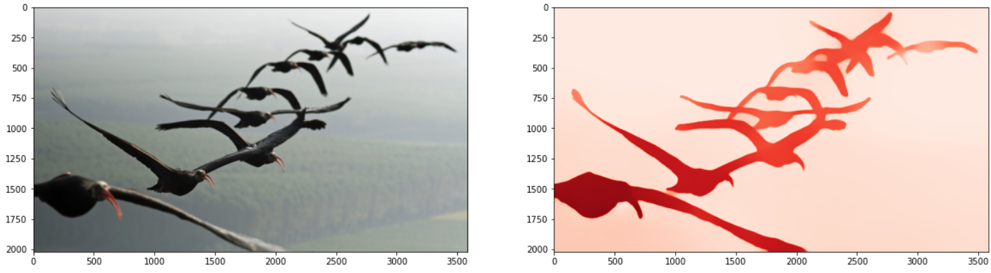
Predictions and Testing on Random Internet Images

Slide 31
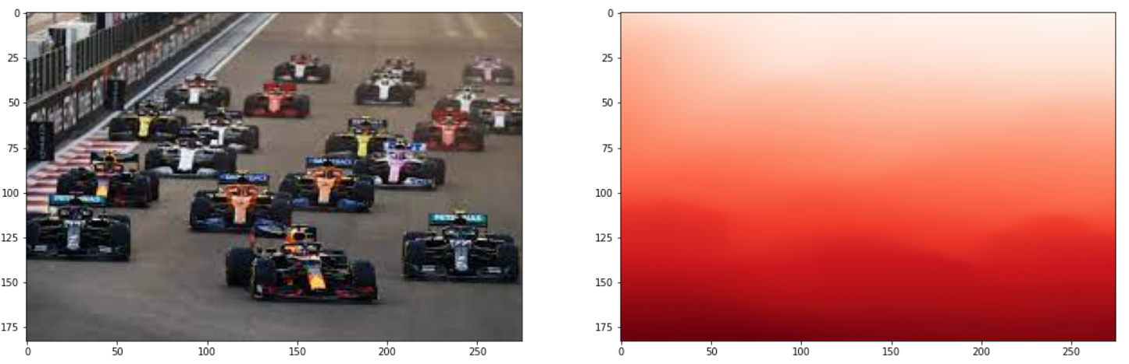
Predictions and Testing on Random Internet Images

Slide 32
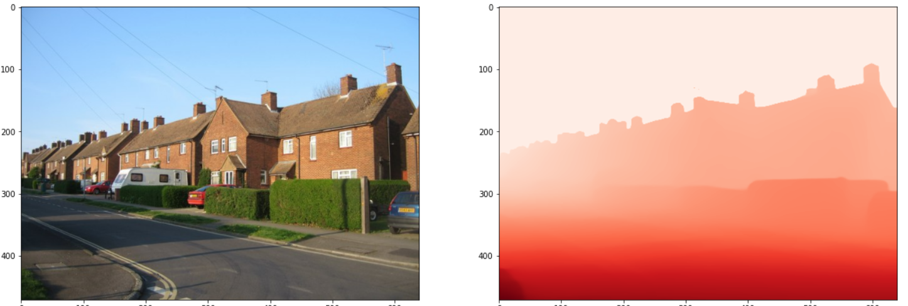
Predictions and Testing on Random Internet Images

Slide 33
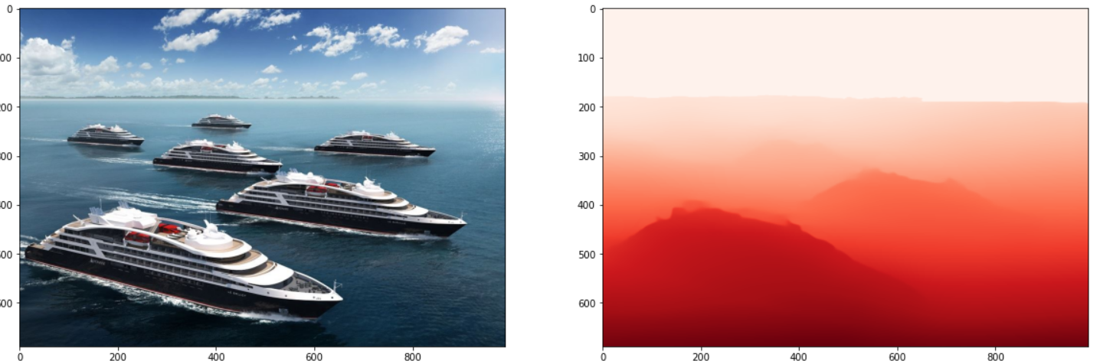
Predictions and Testing on Random Internet Images

Slide 34
Conclusion
Our model is generalized well to dataset therefore performs well.
Does Not performs well on inputs with too many subjects in them or some outlier inputs
Therefore our model has medium Recall but medium Precision
Fine tuning requires more work for s.o.a results
Train More
Search for better hyperparameter selection
Future Scope
More narrow dataset can lead to much better model
Instead of generalized model if we train model specific to vehicle distance detection, it can outperform lidar

Slide 35
References
[1] Towards Robust Monocular Depth Estimation: Mixing Datasets for Zero-shot Cross-dataset Transfer
https://arxiv.org/pdf/1907.01341.pdf
[2] Vision Transformers for Dense Prediction
https://arxiv.org/pdf/2103.13413.pdf
[3] MegaDepth: Learning Single-View Depth Prediction from Internet Photos
https://www.cs.cornell.edu/projects/megadepth/
[4] IWeb Stereo Video Supervision for Depth Prediction from Dynamic Scenes
https://sites.google.com/view/wsvd/home?authuser=0
[5] Depth Estimation on NYU-Depth V2
https://arxiv.org/pdf/2205.13543v2.pdf
[6] SDC-Depth: Semantic Divide-and-Conquer Network for Monocular Depth Estimation
https://arxiv.org/pdf/2205.13543v2.pdf

Slide 36
Thank You

Slide 37
Timeline
Our month wise plan to complete the project is as follows
August
Finalizing the dataset.
Research on generative adversarial networks.
Deciding the architecture of the model.
September- October
Developing the architecture using pytorch
Training the model using pytorch.
Debugging the code.
Retraining the model using wasserstein loss.
November
Concluding the result
Publishing the results.
Submitting the project.

